Slide 1




ECLI Implementation
at the
Hellenic Council of State
BO-ECLI Conference | Athens | 08-06-2017
Georgios Karvelis
Senior IT Expert for BO-ECLI (EPLO)
gkarvelis@eplo.int
This project is co-funded by
the European Union
Notes:
Good evening Ladies and Gentlemen,
My name is George Karvelis and my today’s presentation will deal with the ECLI Implementation in Greece at the Hellenic Council of State, as part of the BO-ECLI project.
The responsible parties for this implementation were the European Public Law Organization (EPLO) and of course the Hellenic Council of State.

Slide 2

The EPLO in Brief
Mission & Establishment
The European Public Law Organization (EPLO) is an international organization dedicated to the creation and dissemination of knowledge in the area of Public Law lato sensu (including but not limited to inter alia national, comparative and European public law, human rights law, environmental law) and Governance and the promotion of European values for a better generation of lawyers and democratic institutions worldwide.
2
Notes:
The European Public Law Organization (EPLO) was established in 2007 in Athens, Greece.
The EPLO is an international organization dedicated to the creation and dissemination of knowledge in the area of Public Law lato sensu (including but not limited to inter alia national, comparative and European public law, human rights law, environmental law) and Governance and the promotion of European values for a better generation of lawyers and democratic institutions worldwide.

Slide 3
The EPLO in Brief
Governance
15 Member States:
Hellenic Republic
Italian Republic
Republic of Cyprus
French Republic
Republic of Estonia
Republic of Serbia
Republic of Moldova
Republic of Azerbaijan
Republic of Armenia
Ukraine
Georgia
Romania
Bosnia and Herzegovina
Republic of Albania
Republic of Hungary
                Its Board of Directors consists of 15 Countries,
                2 International Organizations, 4 Public Authorities
                and 65 Universities/Institutions.
3
Notes:
EPLO’s Board of Directors is comprised of the representatives of 15 countries.

Slide 4
The EPLO in Brief
Governance
2 International Organizations:
European Commission
Council of Europe
4 Public Authorities:
Ministry of Justice, Transparency and Human Rights, Greece
Ministry of Administrative Reform and e-Governance, Greece
Brčko District, Bosnia and Herzegovina
Hellenic Parliament
65 Universities/Institutions - 70 areas of Presence: Afghanistan, Albania, Argentina, Australia, Austria, Armenia, Azerbaijan, Belarus, Belgium, Bangladesh, Barbados, Bosnia and Herzegovina, Bulgaria, Canada, Chile, Colombia, Croatia, Cuba, Cyprus, Czech Republic, Egypt, Estonia, Fiji, France, FYROM, Georgia, Ghana, Germany, Greece, Guatemala, Hungary, India, Iran, Israel, Italy, Jordan, Kazakhstan, Kuwait, Latvia, Lebanon, Libya, Lithuania, Luxembourg, Malta, Mauritius, Mexico, Moldova, Montenegro, Morocco, the Netherlands, Pakistan, Peru, Poland, Portugal, Russia, Romania, Serbia, Somalia, Slovakia, Slovenia, Spain, Sudan, Switzerland, Syria, Thailand, Trinidad and Tobago, Tunisia, Turkey, Ukraine, United Kingdom, Vietnam
4
Notes:
And also 2 International Organizations, 4 Public Authorities and 65 Universities.

Slide 5
The EPLO in Brief
Main Activities
EPLO
Research
Publications
Institution Building & Technical Cooperation
Education & Training
5
Notes:
To this date, it has developed, organized, promoted and supported more than 200 educational, research, training, institution building and other activities and has provided assistance to democratic institutions in more than 70 countries.

Slide 6

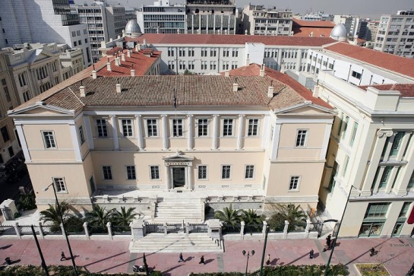
The Hellenic Council of State
  The Hellenic Council of State is the Supreme Administrative Court of Greece.
  The Council of State is at the top of the hierarchy of ordinary administrative courts (administrative courts of first instance and administrative courts of appeal).
  The Hellenic Council of State participates in BO-ECLI as an Associate Partner
6
Notes:
The Hellenic Council of State is the Supreme Administrative Court of Greece.
It is at the top of the hierarchy of ordinary administrative courts (administrative courts of first instance and administrative courts of appeal).
And It participates in the BO-ECLI project as an Associate Partner

Slide 7
The Hellenic Council of State
State of Play
  The Hellenic Council of State publishes the decisions in its website www.adjustice.gr
  Court’s decisions are publicly issued only with respect to anonymity
    Public access: a summary of the most important Court’s decisions (Anonymously)
    Authorized access for Judges, Ministries etc.:
    All decisions (with names)
7
Notes:
The Hellenic Council of State decisions are published in its newly developed website www.adjustice.gr
Court’s decisions are publicly issued only with respect to anonymity
This means that there are two types of access in the Hellenic Council of State Case Law Repository:
Public can access court’s decisions text without seeing names involved, and
There is Authorized access for Judges, Government officials etc.:, where they can access the full text of the decisions, including the names.

Slide 8
BO-ECLI WS1
Activities
  To decide on the structure of ECLI and metadata;
  To assign ECLI and metadata to the historic judgments in the Hellenic CoS’s repository;
  To make the published decisions have an ECLI searchable via the ECLI Search Engine of the European e-Justice Portal (ESE-EEJP), using the technical interface provided by the European Commission.
8
Notes:
As part of the BO-ECLI project, and in order to implement ECLI at the Hellenic Council of State, we had:
To decide on the structure of ECLI and the respective metadata;
To assign ECLI and metadata to the historic judgments in the Hellenic CoS’s repository;
To make the published decisions have an ECLI code assigned, searchable via the ECLI search engine of the European e-Justice Portal, using the technical interface provided by the European Commission.

Slide 9
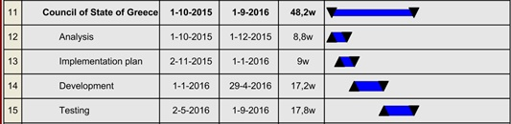
BO-ECLI WS1
Timeline
9
Notes:
For achieving the above goals, we had to follow the displayed detailed Tasks, following the respective Time Schedule.
In general, we started at 1st October 2015 and we had to have everything implemented and running in 11 months, until 1/9/2016.

Slide 10
BO-ECLI WS1
Expected Deliverables
  50.000 historical decisions having an ECLI assigned and indexed by ESE-EEJP expected, after the implementation of ECLI at CoS
  5.000 annual growth of decisions, after the completion of the project (estimated).
10
Notes:
According to the Project spefications, the Deliverables expected, were:
50.000 historical decisions having an ECLI assigned and indexed by the ECLI Search Engine of the European e-Justice Portal,
5.000 annual growth of decisions, after the completion of the project.

Slide 11
BO-ECLI WS1
People/Roles
  Involved Persons/Roles:
  Georgios Karvelis (EPLO): Senior IT Expert, responsible for the technical implementation of ECLI at CoS and the ESE-EEJP interconnection
  Effie Lyristi (EPLO): Senior Legal Expert, responsible for managing EPLO, CoS, MoJ communication and coordination of activities for ESE-EEJP
  Eleni Kefali (EPLO): Senior Legal Expert, responsible for legal input for the implementation of ECLI at CoS and the ESE-EEJP interconnection
  Nikolaos Sekeroglou(Hellenic CoS): Associate Councilor at Hellenic CoS, contact point for BO-ECLI
11
Notes:
The Involved Persons in this implementation project were:
From EPLO myself as a Senior IT Expert, and Ms Lyristi and Ms Kefali as Senior Legal Experts
And from the Hellenic CoS, Mr Nikolaos Sekeroglou, Associate Councilor, who was our contact point for the project

Slide 12



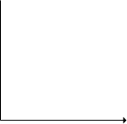






ECLI Structure at the Hellenic CoS
ECLI:
EL:
COS:
2014:
01
03
A
2.
13
E
3681
Case Registration Number
Case Registration Book code
Case Registration Year
Decision Number
Registration Book of the decision
Publication Day of the decision
Publication Month of the decision
Publication Year of the decision
Court code
Country Code
ECLI Abbreviation
12
Notes:
One of the most important tasks was to decide about the Structure of the ECLI code.
For this, we had to follow the general rules of the ECLI structure and to study thoroughly the existing decision numbering mechanism of the Case Law Repository of the Hellenic CoS.
The following example illustrates the five components of the ECLI code in the Hellenic CoS:
ECLI Abbreviation
Country Code for Greece EL, based on the EU Publication Office recommendation
Court code (Decided to be COS instead of STE (which is the Greek Abbreviation of the Hellenic CoS), in order have a meaningful code for the international legal community
Year of the decision
The fifth element of the ECLI code, which is the <ordinal number>, is defined in such a way, in order to ensure it’s uniqueness within the entire Hellenic CoS’s case law repository.
In that respect, the First part of the ordinary number, consists of:
The Publication Month of the decision
The Publication Day of the decision
The Registration Book of the decision, which is actually one ore two capital letters representing the specific Registration “book” in which the decision has been registered)
Decision Number (represents the actual number of a decision registered in this particular <Registration Book> in the particular <year>)
The Second part of the ordinary number, consists of:
the Case Registration Year (of the respective case for the decision)
the Case Registration Book code of that case, and
the Case Registration Number (which represents the actual number of the respective case for the decision, registered in this particular <Case Registration Book> in the particular <year>)

Slide 13
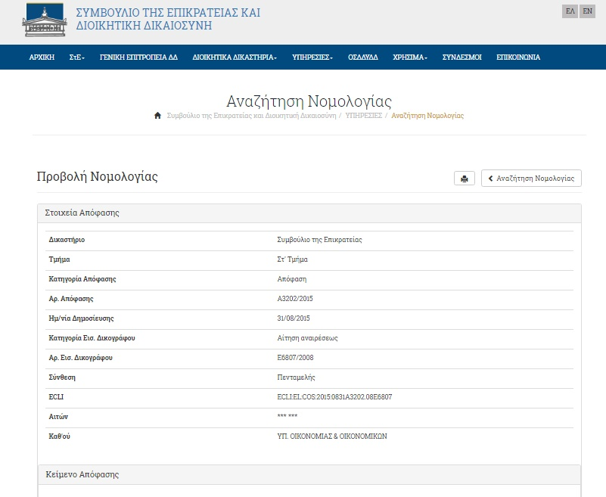

13
Notes:
This is how all the relative information about a decision is presented when searching in the publicly accessed Hellenic Council of State’s Case Law Repository,
together with the assigned ECLI code

Slide 14
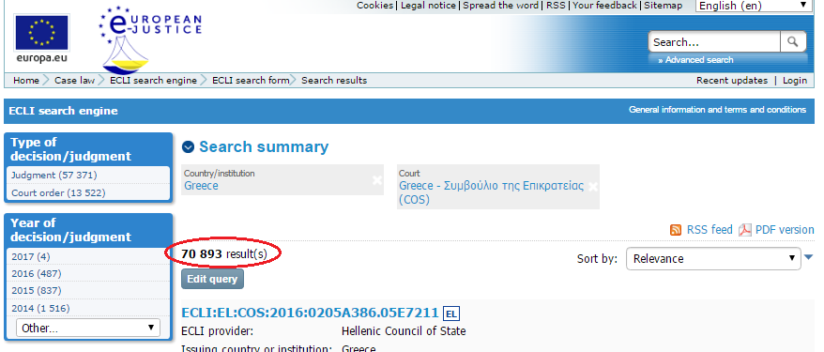
ECLI Implementation at Hellenic CoS
Achieved Results / Current Status
  ECLI implemented successfully on-time and in-budget at the Hellenic Council of State
  70.893 historical decisions (till today) assigned an ECLI and indexed by ESE-EEJP, instead of 50.000 expected
  Automatic assignment of an ECLI code to every new published decision of the Hellenic Council of State
  Extra added value to the Hellenic Council of State’s Case Law Repository, by transforming information into knowledge.
14
Notes:
What have we achieved?
ECLI implemented successfully on-time and in-budget at the Hellenic Council of State
Almost 71.000 historical decisions (till today) assigned an ECLI and indexed by ECLI Search Engine of the European e-Justice Portal, instead of 50.000 expected
From now on, when a new decision is published in the Hellenic Council of State’ Case Law Portal, an ECLI code is automatically assigned and it is indexed in the ECLI Search Engine of the European e-Justice Portal
Judges, court officers, lawyers, citizens, as well as the Greek and the International legal community can now search on Hellenic Council of State’s decisions, using the powerful EU ECLI Search Engine, giving in that way, an extra added value to it’s Case Law Repository, by transforming information into knowledge.

Slide 15
Thank you very much
for your attention!
BO-ECLI Conference | Athens | 08-06-2017
Georgios Karvelis
Senior IT Expert for BO-ECLI (EPLO)
gkarvelis@eplo.int
This project is co-funded by
the European Union
This presentation has been produced with the financial support of the Justice Programme of the European Union. The contents of this publication are the sole responsibility of the partners of the BO-ECLI project and can in no way be taken to reflect the views of the European Commission.
Notes:
Thank you very much for your attention!

